Slide 1
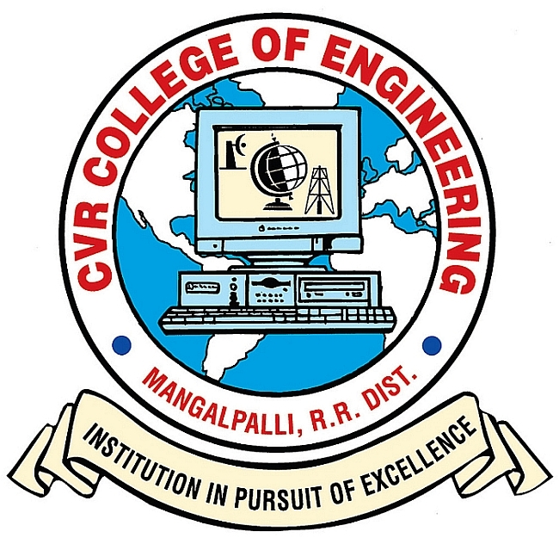
CVR COLLEGE OF ENGINEERING DEPARTMENT OF COMPUTER SCIENCE AND ENGINEERING
A Project seminar-I
on
ART GENERATION WITH NEURAL STYLE TRANSFER
by
P.SREENIDHI-20B81A05A7
B.ASHISH PREETHAM-20B81A0566
Under guidance of
N.N.S.S.S.Adithya
(Assistant Professor)

Slide 2
Contents
Abstract
Motivation
Literature review and Limitations of the existing models
Proposed problem statement
Proposed approach of the work
User requirement analysis
Software requirements
Hardware requirements
Data sets requirement
Architecture of the project
System Design
Modules in code
Main functions and its implementation in the Code
Snippet of code
Innovation in the project
Plan of action to complete the project
References

Slide 3
Abstract
Neural Style Transfer is the technique of blending style from one image into another image keeping its content intact. The only change is the style configurations of the image to give an artistic touch to your image. It is an application of Computer Vision related to image processing techniques and Deep Convolutional Neural Networks. Neural Style Transfer deals with two sets of images: Content image and Style image. Style transfer works by activating the neurons in a particular way, such that the output image and the content image should match particularly in the content, whereas the style image and the desired output image should match in texture and capture the same style characteristics in the activation maps. Convolutional Neural Networks (CNNs) form the backbone of this process, with architectures like VGG19, a deep convolutional neural network architecture, comprises 19 layers, including 16 convolutional layers and three fully connected layers. It excels at image classification tasks by employing small 3x3 convolutional filters throughout its deep structure, capturing intricate features and patterns in the input images. Algorithms, such as the Gram matrix computation for style representation and Total Variation minimization for smoothing, contribute to refining the generated artwork. Additionally, it discusses challenges, advancements, and future directions in the dynamic field of Art Generation through Neural Style Transfer.

Slide 4
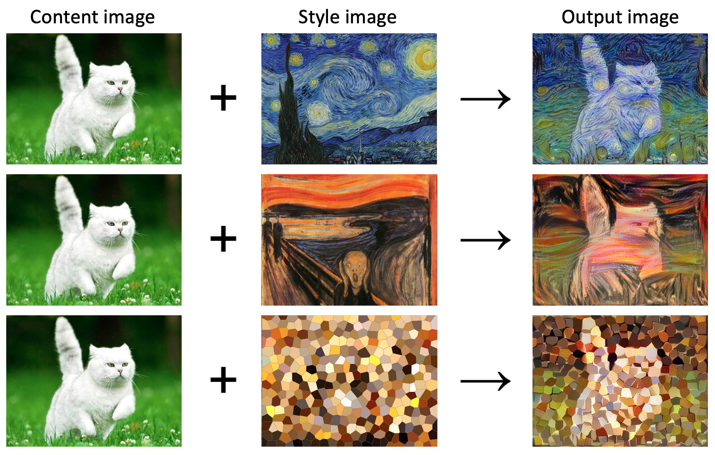
Motivation
The motivation behind art generation using neural style transfer projects lies in the fusion of artistic expression and artificial intelligence. Neural style transfer is a technique that leverages deep neural networks to apply the artistic style of one image (e.g., a painting) to the content of another image (e.g., a photograph). These projects showcase the potential of AI to contribute to the artistic process and inspire new forms of creative expression.
Some key motivations for undertaking such projects:
Blend of Styles
Experimentation with Styles
Personalization and Customization
Understanding Neural Networks
Visual Effects in media and entertainment
Inspiration from Art History
Showcasing AI Capabilities
Advancements in Image Processing

Slide 5
Literature review
source | Author | Year | Methodology | Key Findings | Limitations
1 | Gatys et al. | 2015 | Neural Style Transfer (NST) | Introduces NST using deep neural networks | Limited customization, lack of spatial coherence
2 | Ulyanov et al. | 2016 | Instance Normalization for NST | Improves NST with instance normalization | Limited exploration of diverse artistic styles
3 | Liao et al. | 2017 | Adaptive Instance Normalization | Proposes adaptive instance normalization in NST | Overfitting to training data, lack of user control
4 | Jing et al. | 2018 | Arbitrary Style Transfer with CNN | Applies arbitrary style transfer with CNN | Limited exploration of temporal aspects

Slide 6
Proposed problem statement
Artists, designers, and enthusiasts lack a seamless and user-friendly platform for artistic expression through neural style transfer. Existing tools fall short in providing a dynamic and intuitive approach to blend diverse artistic styles, limiting creative possibilities. The absence of a unified solution hinders the generation of visually captivating artworks, digital art creation, and effective image enhancement. The challenge is to develop an innovative application that not only addresses these limitations but also accommodates users with varying levels of artistic expertise. This project aims to bridge the gap by creating a user-centric, accessible, and efficient neural style transfer platform, opening new horizons in design, content generation, and creative tools.

Slide 7
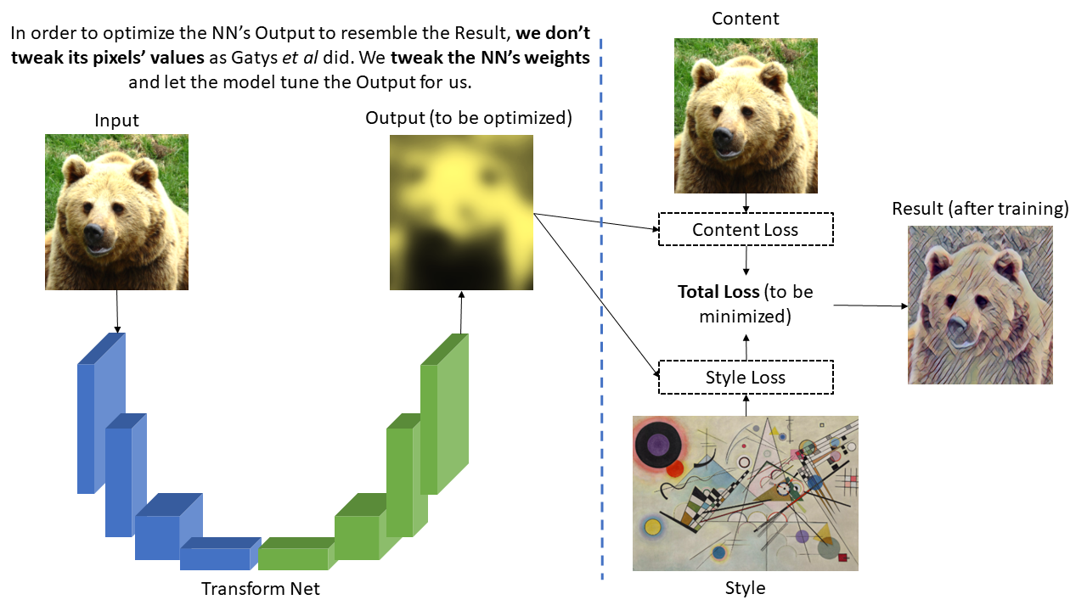
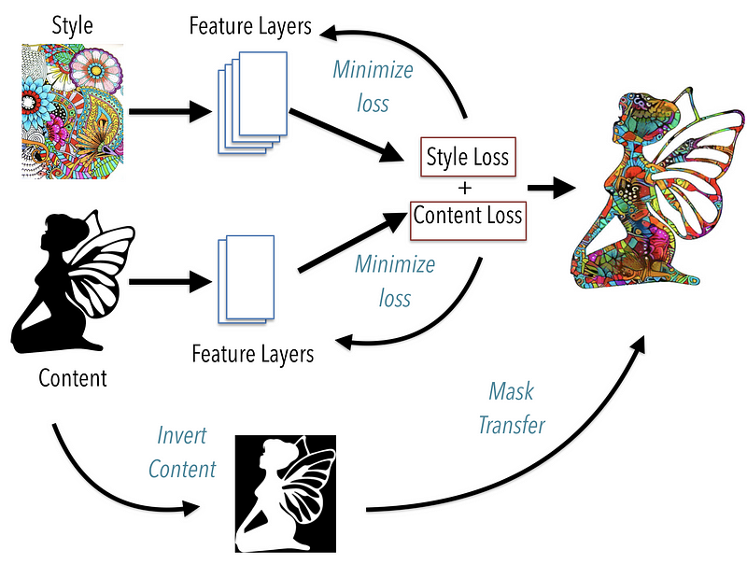
Proposed approach of the work
How NST Works
NST involves two main steps: extracting features from content and style images and combining these features to generate a new image.
Content features are extracted from a pre-trained convolutional neural network (CNN), which learns to recognize objects and shapes.
Style features are extracted by analyzing the correlations between different filters of the CNN.

Slide 8
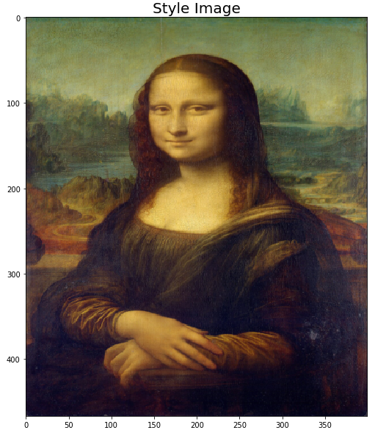
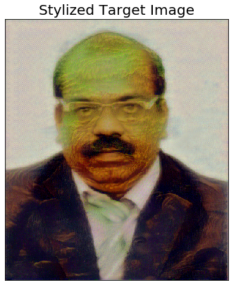
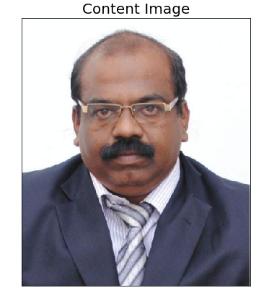

Slide 9
User requirement analysis
User/Stakeholder require Python and web browser to run the application
Identify Target Users and Understanding the Audience.
User Goals - Express artistic creativity through neural style transfer, User-friendly experience, Real-time preview and customization options.
Use Cases- Artistic Expression, Digital Art Creation, Image Enhancement.
Key Features- Style configuration, Real-time Preview and Compatibility.
Ensuring Smooth Performance.
Feedback Mechanisms.
Integration with Existing Workflows.
Legal and Ethical Considerations.
User Interface (UI) Preferences.
This user requirement analysis outlines the specific needs and expectations of the target users, covering both functional and non-functional aspects, as well as ethical considerations and feedback mechanisms. Customize this analysis further based on the specific context and goals of your project.

Slide 10
Software requirements
Python 3.9.4 (both for backend and frontend)
Libraries:
TensorFlow and Pytorch(DNN Libraries)
OpenCV (Image Processing)
Pillow/PIL(Image Handling)
Pandas (Data Frame)
NumPy (Numeric, Array and Matrix Operations)
PyWebIo (User Web Interface)

Slide 11
Hardware requirements
Development:
NVIDIA P100 8 GB GPU
I5 8th gen CPU
16 GB RAM
256 SSD
Ubuntu 20.04 LTS OS
With CUDA, CUDNN Setup
(Which we will be compensating with Kaggle)
Deployment/Inference:
I3 5th gen > CPU
4 GB RAM
Windows OS
256 > HDD/SSD

Slide 12
Data sets requirement
We will collect our own dataset with two types of images
Hand drawn Art Styles like Acrylic, Dotted, photorealistic and Retro – Style Image
Target images which is captured with cell phones and computer web cam – Content Image

Slide 13
Architecture of the Project
Input Stage
Load Content Image
Load Style Image
Pre-processing
Load Pre-trained Convolutional Base (e.g., VGG19)
Extract Features (Content Layers and Style Layers)
Calculate Content Loss
Calculate Style Loss
Combine Content and Style Loss
Optimization
Update Generated Image Iteratively
Output Stage
Final Generated Image

Slide 14
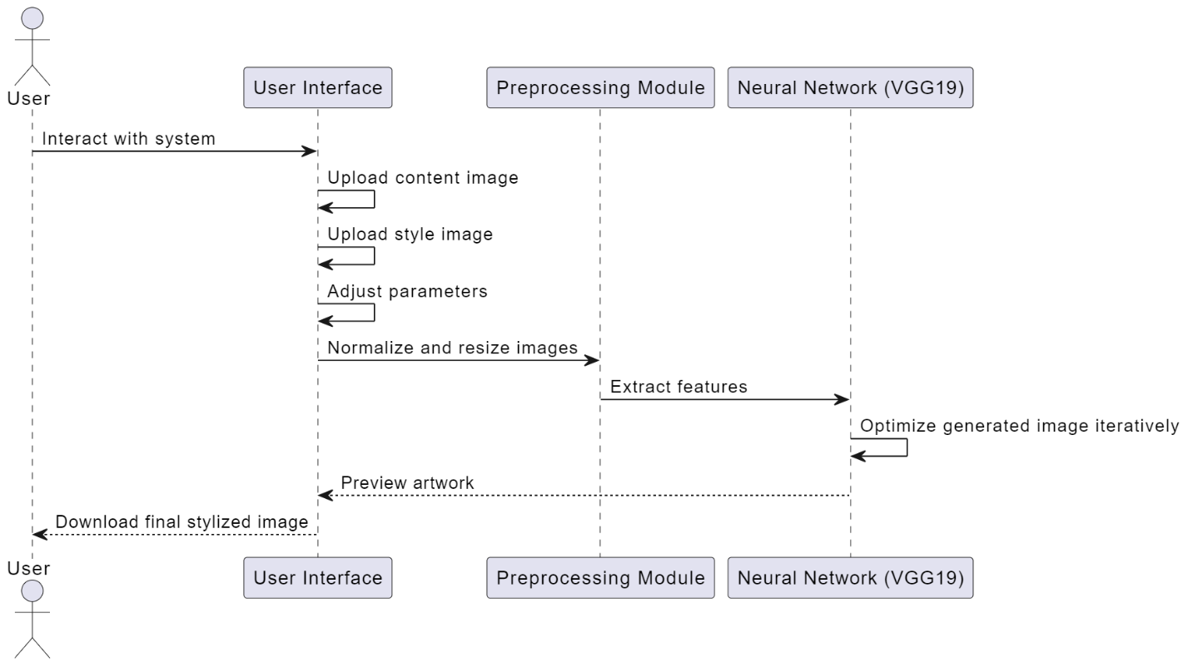
System Design
UML Diagrams:
Sequence Diagram

Slide 15
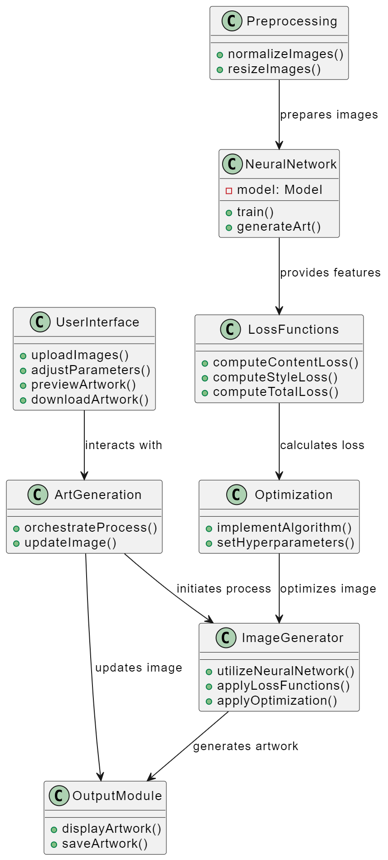
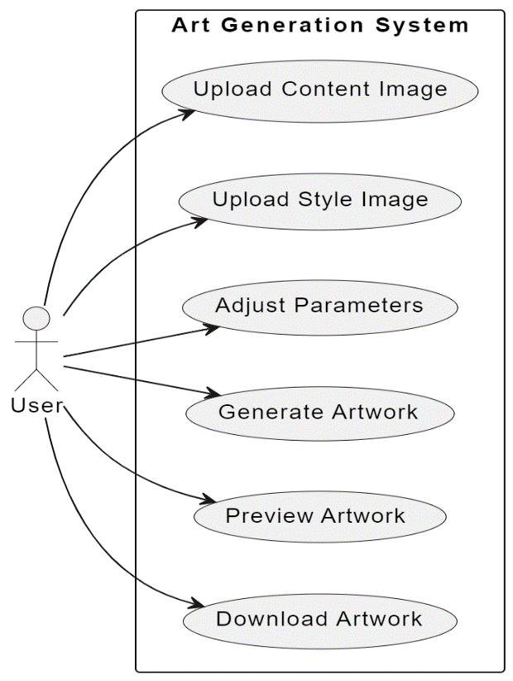
Use-case Diagram
Class Diagram
15

Slide 16
Modules in the code
Separating Style and Content
Load in VGG19 (features)
Load in Content and Style Images
VGG19 Layers
Gram Matrix
Loss and Weights
Updating the Target & Calculating Losses
Display the Target Image

Slide 17
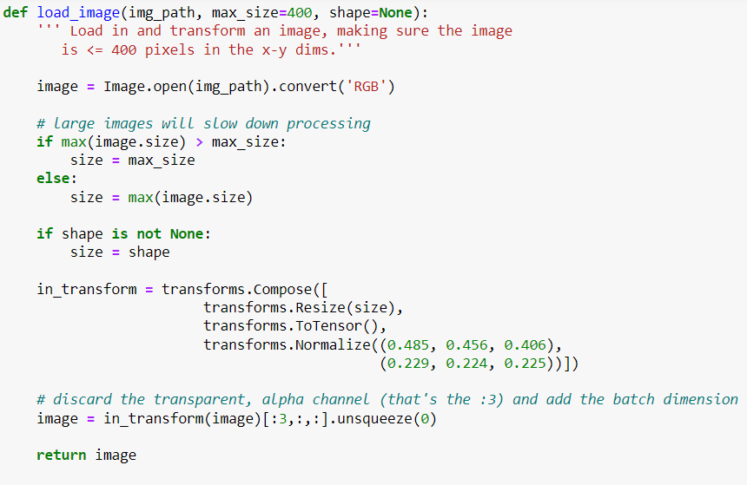
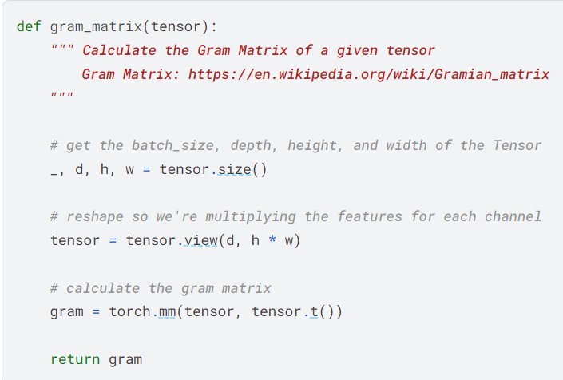
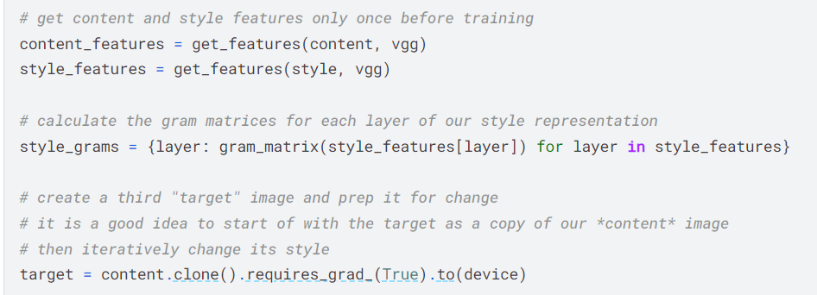
Main functions and its implementation in the Code

Slide 18
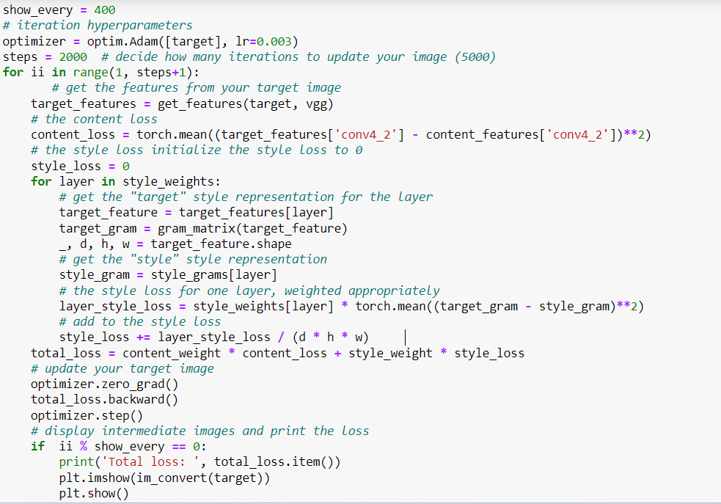
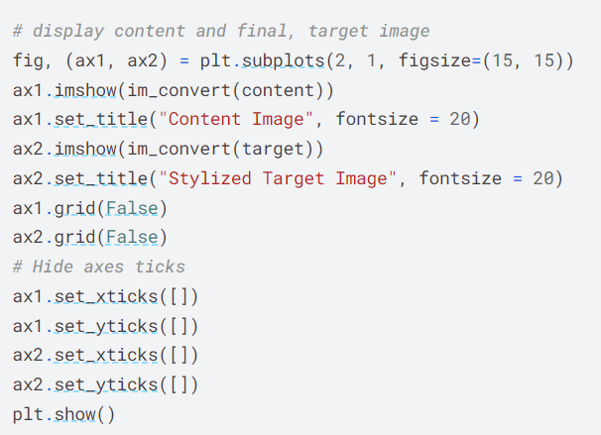
Final display the target image
Updating the Target & Calculating Losses

Slide 19
Snippet of code
ANS_pytorch | Kaggle

Slide 20
Innovation in the project
Interactive User Control
Cross-Domain Style Transfer
Temporal Art Generation
AI-Driven Artistic Suggestions
Augmented Reality (AR) Integration
Pytorch Implementation
Advancements in Art Generation
By incorporating these innovative elements into your art generation project, you not only enhance its appeal but also contribute to pushing the boundaries of creativity and user engagement. Our innovation is to design a web interface where you upload the target/input image, and it will be visualized in various art styles . We also introduce very simple and clean web interface which is easy to use for any non-technical person and layman.

Slide 21
Plan of action to complete the project
We began our journey by studying a paper from Gatys and team, diving into the world of Image Style Transfer Using Convolutional Neural Networks. This helped us grasp the concept of neural style transfer and its cool application in creating Art. To kick things off practically, we started collecting our dataset. For the technical side, we chose Kaggle as our playground and relied on the powerful Pytorch library for the backend. Right now, we're at a stage where we can turn any regular image into a piece of art using a command line interface.
But wait, it gets even more exciting! Our next step is to simplify this process into a three-step magic trick. Imagine transforming an image into a beautiful art style seamlessly. How? With a user-friendly web interface called PywebIo.

Slide 22
References
Neural style transfer | TensorFlow Core
Neural Style Transfer: Reliving art through Artificial Intelligence | IEEE Conference Publication | IEEE Xplore
Neural Style Transfer and Visualization of Convolutional Networks | by Matthew Stewart, PhD | Towards Data Science
A Comprehensive Guide to Convolutional Neural Networks — the ELI5 way | by Sumit Saha | Towards Data Science
Gatys, L. A., Ecker, A. S., & Bethge, M. (2016). Image Style Transfer Using Convolutional Neural Networks ->
Image Style Transfer Using Convolutional Neural Networks (cv-foundation.org)
GitHub repository for Neural Style Transfer with Pytorch:
examples/fast_neural_style at main · pytorch/examples · GitHub

Slide 23

Thank You!

